Slide 1

ALL LIFE BANK CUSTOMER SEGMENTATION
By
Lavina Kunder

Slide 2

BACKGROUND
AllLife Bank wants to focus on its credit card customer base in the next financial year. They have been advised by their marketing research team, that the penetration in the market can be improved. Based on this input, the Marketing team proposes to run personalized campaigns to target new customers as well as upsell to existing customers. Another insight from the market research was that the customers perceive the support services of the back poorly. Based on this, the Operations team wants to upgrade the service delivery model, to ensure that customer queries are resolved faster. Head of Marketing and Head of Delivery both decide to reach out to the Data Science team for help

Slide 3
PROBLEM DEFINITION
Explore and visualize the dataset.
Data Preprocessing.
K Means Clustering
Hierarchical Clustering
Compare clusters from K-means and Hierarchical Clustering and perform cluster profiling
To identify different segments in the existing customer, based on their spending patterns as well as past interaction with the bank
Using clustering algorithms
Provide recommendations to the bank on how to better market to and service these customers.
Generate a set of insights and recommendations.

Slide 4
DATA INFORMATION
There are 7 attributes of type INTEGER.
There are 0 attributes of type FLOAT.
There are 0 attributes of type OBJECT.
TOTAL : 7 Attributes.
There are 660 rows and 7 columns

Slide 5
DATA PREPROCESSING I
This part of Data Pre-processing is done to understand the DataSet better and for UNIVARIATE and BIVARIATE Exploratory Data Analysis.
Further Data Pre-processing will be done after EDA is complete.
Pre Processing Done :
1) DROP UNNECESSARY COLUMNS (Sl_No, Customer Key)
2) CHECK FOR DUPLICATE ROWS

Slide 6
UNIVARIATE ANALYSIS

Slide 7
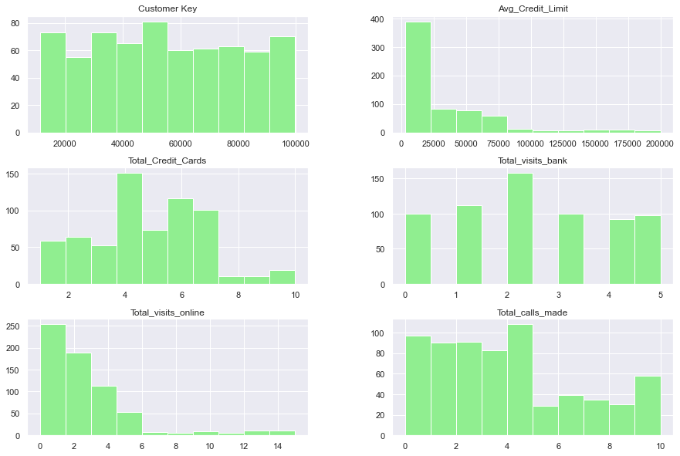
Histogram Plots
Histogram Plots of the various numerical Attributes present in the given Dataset. It shows the frequency of each element within the attribute.

Slide 8
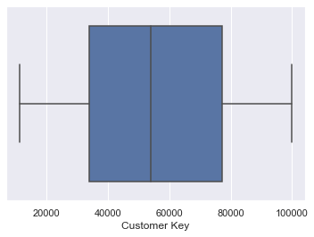
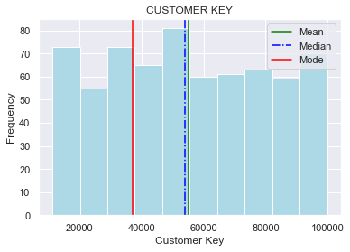
CUSTOMER KEY DISTRIBUTION
Even Distribution
No significant information can be extracted from this attribute.

Slide 9
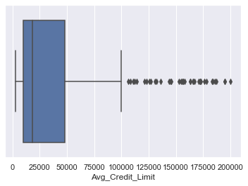
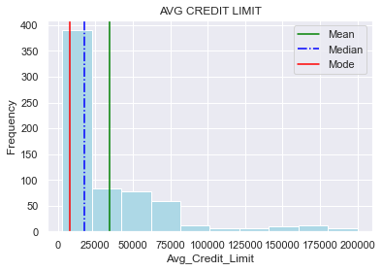
AVERAGE CREDIT LIMIT DISTRIBUTION
Mode < Median < Mean
Highly Skewed
Many Outliers
Most of the customers have a credit limit in the range of 0 - 50000

Slide 10
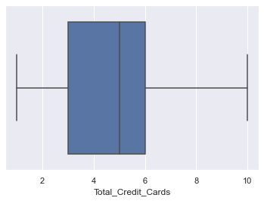
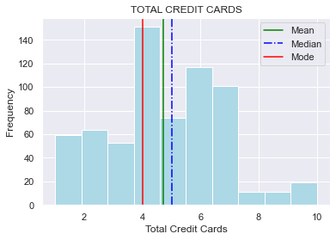
TOTAL CREDIT CARDS DISTRIBUTION
Mode < Mean < Median
Mostly evenly distributed.
No Outliers
Most of the customers have a total credit cards in the range of 4 - 7

Slide 11
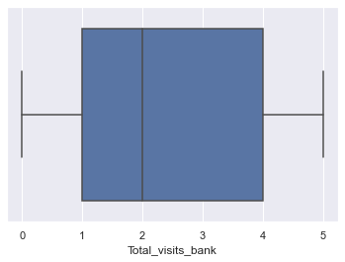
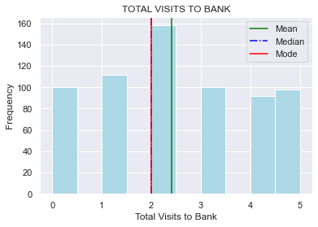
TOTAL VISITS BANK DISTRIBUTION
Mode = Median < Mean
Most customers have visited the bank only twice.

Slide 12
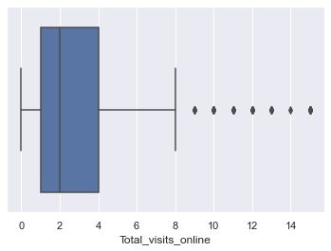
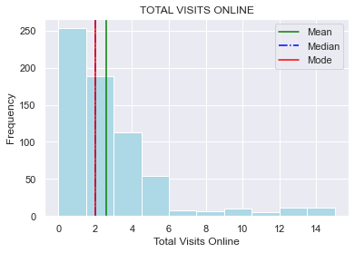
TOTAL VISITS ONLINE DISTRIBUTION
Mode = Median < Mean
Highly Skewed
Outliers present
Most of the customers have visited the website of the bank online in the range of 0 - 6

Slide 13
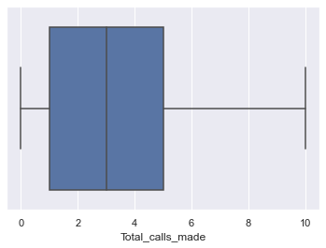
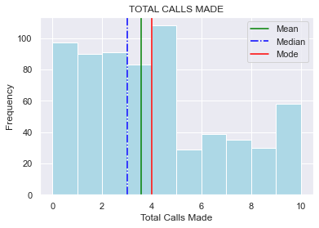
TOTAL CALLS MADE DISTRIBUTION
Median < Mean < Mode
No Outliers
Most of the customers have made calls to the bank in the range of 0 - 5

Slide 14
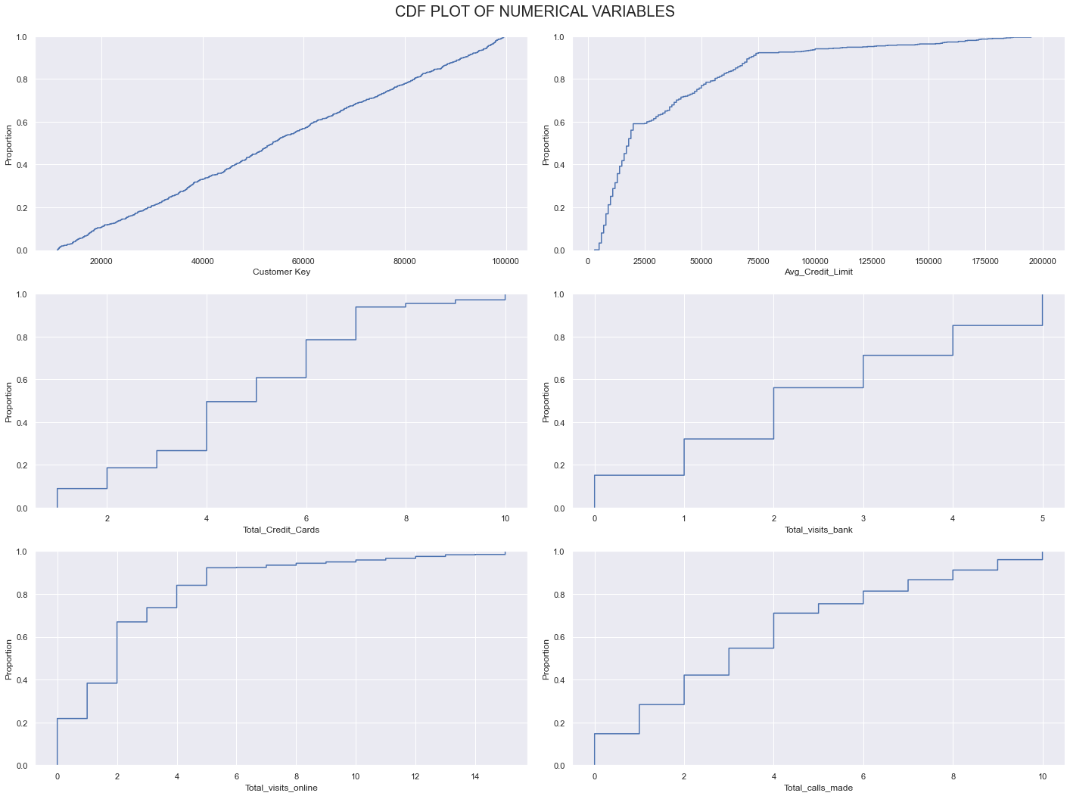
CDF PLOT

Slide 15
CDF PLOT
Over 90% of the customers have an average credit limit only upto 75000
90% of the dataset has upto 7 credit cards only with a very small percentage of customers have 7+ credit cards.
80% of the customers have visited the bank upto 4 times.
90% of the customers have made visits to the online website only up to 6 times. only 10% of the customers have visited the online website more than 7 times.
70% of customers have made calls in the range of 0 - 4. Only the remaining 30% have made 4 or more calls.

Slide 16
BIVARIATE & MULTIVARIATE ANALYSIS

Slide 17
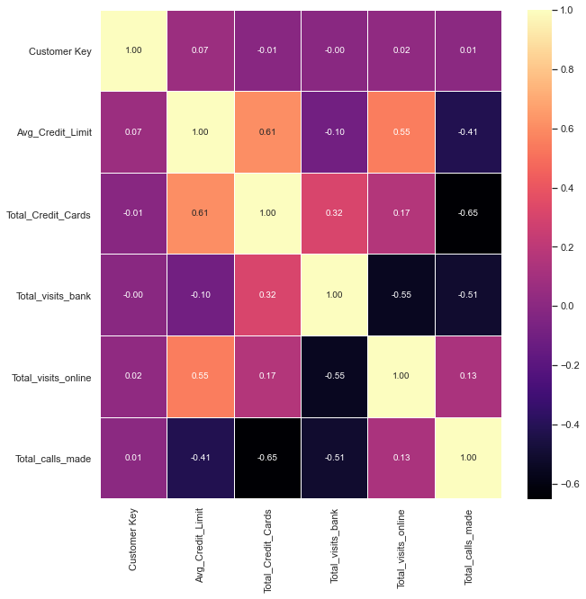
Correlation Heat Map
This Heat Map shows the correlation between the individual attributes. There is distributed correlation between the attributes of this dataset. With this we can draw the following inferences :
HIGH CORRELATION : Avg_Credit_Limit and Total_Credit_Cards, Avg_Credit_Limit and Total_Visits_Online.
MEDIUM CORRELATION : Total_Credit_Cards and Total_Visits_Bank
NEGATIVE CORRELATION : Avg_Credit_Limit and Total_Visits_Bank, Avg_Credit_Limit and Total_calls_made, Total_calls_made and Total_Credit_Cards, Total_Visits_Bank and Total_calls_made, Total_Visits_Bank and Total_Visits_Online.

Slide 18
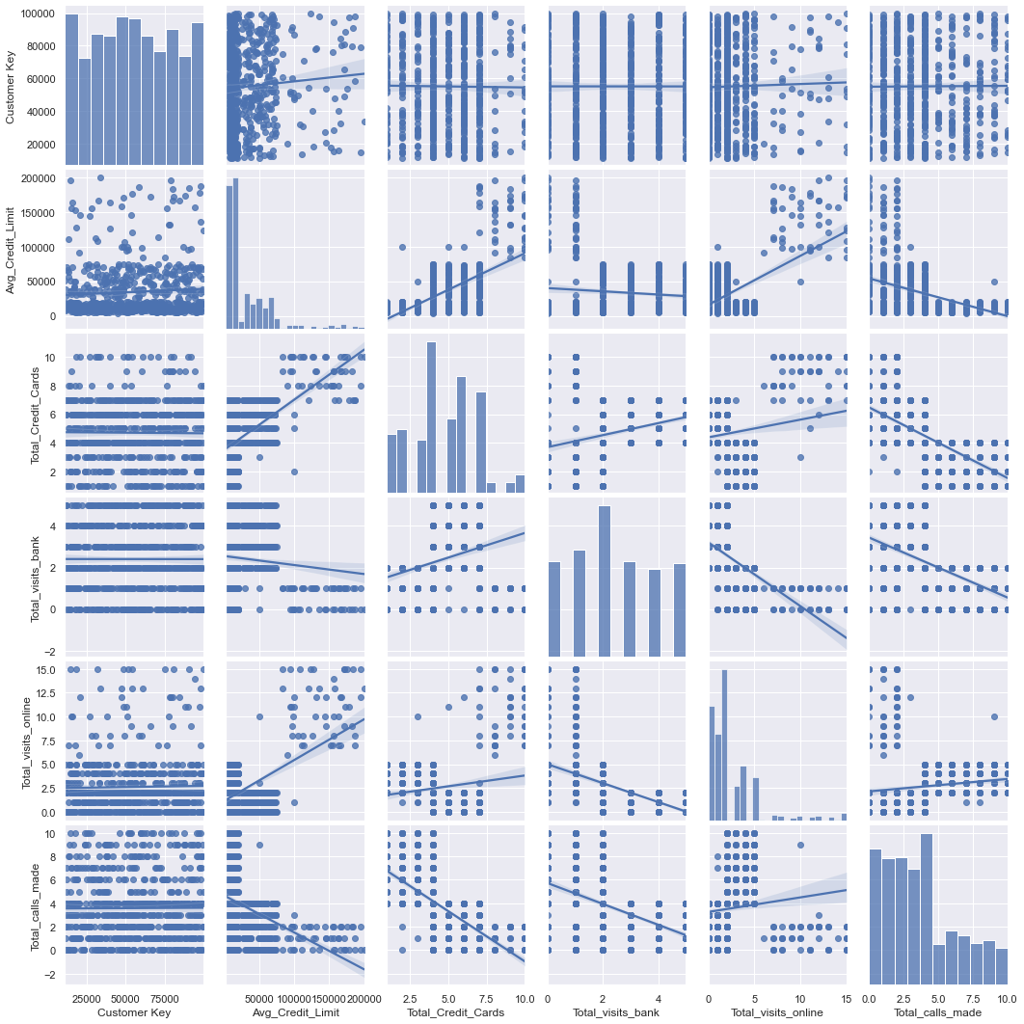
Pair Plot
Pairplot to show the relationship between the different variables. It is a more graphical representation of the Correlation Heat Map.

Slide 19
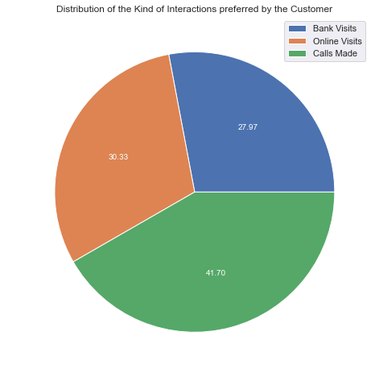
PREFERRED INTERACTIONS
OBSERVATIONS
Most of the customer (40%) prefers to call the bank rather than visit the website or make personal visits.
Bank Visits and Online Visits are almost evenly distributed between in and around 30% each.

Slide 20
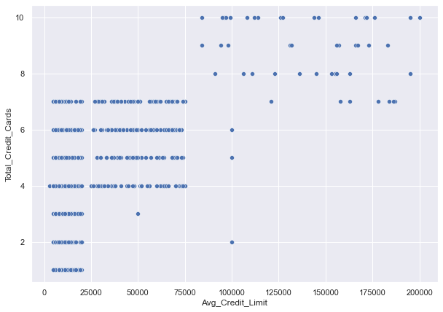
AVG CREDIT LIMITS V/S TOTAL CREDIT CARDS
OBSERVATIONS
There are 2 very distinct clusters.
Cluster 1 : Customers with Avg_Credit_Limit <= 75000 and Total_Credit_Cards <= 7
Cluster 2 : Customers with Avg_Credit_Limit > 75000 and Total_Credit_Cards > 7
Greater the Avg_Credit_Limit, greater the number of credit cards a cutsomer has.

Slide 21
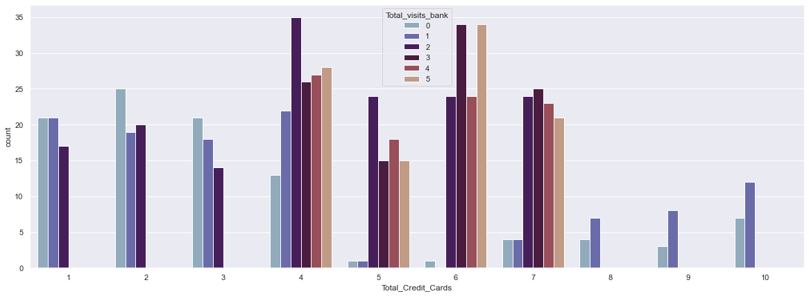
TOTAL VISITS BANK V/S TOTAL CREDIT CARDS

Slide 22
TOTAL VISITS BANK V/S TOTAL CREDIT CARDS
OBSERVATIONS
Total Visits to the bank is at its highest for customers who have credit cards in the range of 4 - 7
Customers with 8 or more credit cards either never visit the bank or have only visited once.
Customers with 3 or less credit cards either never visit the bank or have only visited once or twice..

Slide 23
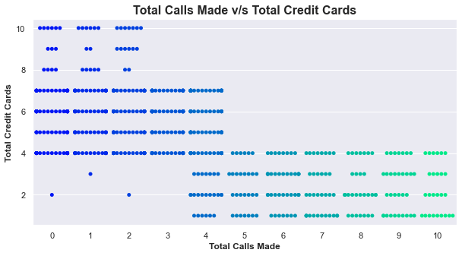
TOTAL CALLS MADE V/S TOTAL CREDIT CARDS
OBSERVATIONS
There are 2 very distinct clusters.
Cluster 1 : Customers with Total Calls Made <= 4 and Total_Credit_Cards > 4
Cluster 2 : Customers with Total Visits Online >= 4 and Total_Credit_Cards <= 4
Greater the number of credit cards a customer has, less likely they are to call the bank.

Slide 24
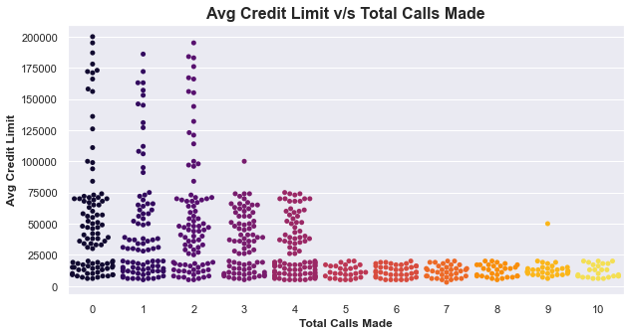
TOTAL CALLS MADE V/S AVERAGE CREDIT LIMIT

Slide 25
TOTAL CALLS MADE V/S AVERAGE CREDIT LIMIT
OBSERVATIONS
Customers that have made 5 or more calls to the bank have Avg_Credit_Limit less than 25000
Customers who have made 3 - 4 calls to the bank have Avg_Credit_Limit less than or equal to 75000
Customers who have made 0 - 2 calls to the bank have Avg_Credit_Limit upto 200000
Number of total calls made to the bank decreases with an increase in Avg Credit Limit.

Slide 26
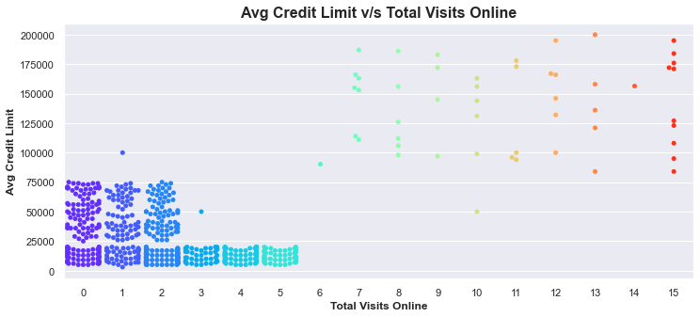
TOTAL VISITS ONLINE V/S AVERAGE CREDIT LIMIT

Slide 27
TOTAL VISITS ONLINE V/S AVERAGE CREDIT LIMIT
OBSERVATIONS
Customers that have made 6 or more online visits have Avg_Credit_Limit greater than 90000
Customers who have made 3 - 5 online visits have Avg_Credit_Limit less than 25000
Customers who have made 0 - 2 online visits have Avg_Credit_Limit upto 75000
Number of online visits or logins to the bank website increases with an increase in Avg Credit Limit.

Slide 28
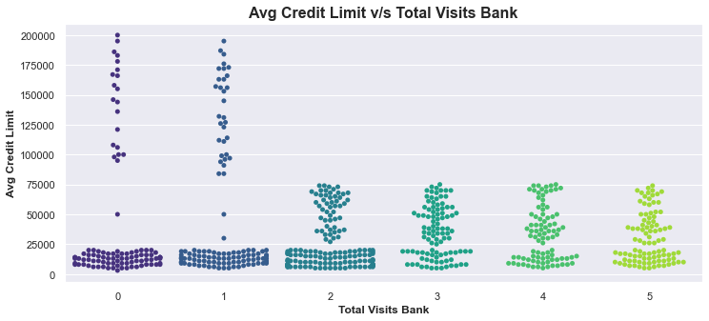
TOTAL VISITS BANK V/S AVERAGE CREDIT LIMIT

Slide 29
TOTAL VISITS BANK V/S AVERAGE CREDIT LIMIT
OBSERVATIONS
Customers that have made 2 or more bank visits have Avg_Credit_Limit upto 80000
Customers who have made 0 - 2 bank visits have Avg_Credit_Limit upto 200000
Number of bank visits decreases with an increase in Avg Credit Limit.

Slide 30
Key Insights based on EDA
Most of the customers have a credit limit in the range of 0 - 50000
Most of the customers have a total credit cards in the range of 4 - 7
Most customers have visited the bank only twice.
Most of the customers have visited the website of the bank online in the range of 0 - 6
Most of the customers have made calls to the bank in the range of 0 - 5
Over 90% of the customers have an average credit limit only upto 75000
90% of the dataset has upto 7 credit cards only with a very small percentage of customers have 7+ credit cards.
80% of the customers have visited the bank upto 4 times.
90% of the customers have made visits to the online website only upto 6 times. only 10% of the customers have visited the online webist more than 7 times.

Slide 31
Key Insights based on EDA
70% of customers have made calls in the range of 0 - 4. Only the remaining 30% have made 4 or more calls.
Most of the customer (40%) prefers to call the bank rather than visit the website or make personal visits.
Bank Visits and Online Visits are almost evenly distributed between in and around 30% each.
Greater the Avg_Credit_Limit, greater the number of credit cards a cutsomer has.
Total Visits to the bank is at its highest for cutsomers who have credit cards in the range of 4 - 7
Customers with 8 or more credit cards either never visit the bank or have only visited once.
Customers with 3 or less credit cards either never visit the bank or have only visited once or twice.
Greater the number of credit cards a customer has the greater thr number of Total Visits Online.
Greater the number of credit cards a customer has, less likely they are to call the bank.

Slide 32
Key Insights based on EDA
Number of total calls made to the bank decreases with an increase in Avg Credit Limit.
Customers that have made 6 or more online visits have Avg_Credit_Limit greater than 90000
Customers who have made 3 - 5 online visits have Avg_Credit_Limit less than 25000
Customers who have made 0 - 2 online visits have Avg_Credit_Limit upto 75000
Number of online visits or logins to the bank website increases with an increase in Avg Credit Limit.
Customers that have made 2 or more bank visits have Avg_Credit_Limit upto 80000
Customers who have made 0 - 2 bank visits have Avg_Credit_Limit upto 200000
Number of bank visits decreases with an increase in Avg Credit Limit.

Slide 33
DATA PREPROCESSING II
FEATURE ENGINEERING
This part of Data Preprocessing is done to cater to the Clustering part of the project. It will help in easier development of the Clustering Graphs
CONTINUATION : Pre-Processing Done:
3) FIXING MISSING VALUES : No values to be fixed
4) DROPPING UNNECESSARY COLUMN and CHECK FOR DUPLICATE ROWS
5) OUTLIERS AND THEIR TREATMENT : Identifying the outliers in all columns and treating them
6) STANDARD SCALING

Slide 34
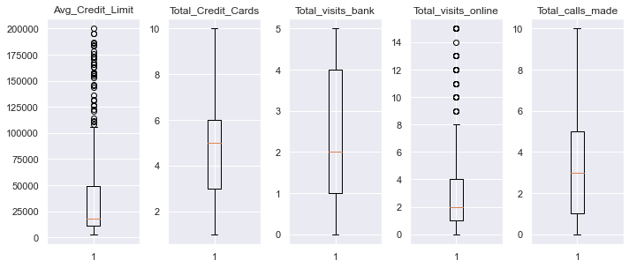
DATA PREPROCESSING II
The outliers will be left untreated as firstly, there aren't many outliers.
Secondly, these outliers may prove to be important data during clustering.

Slide 35
K MEANS CLUSTERING

Slide 36
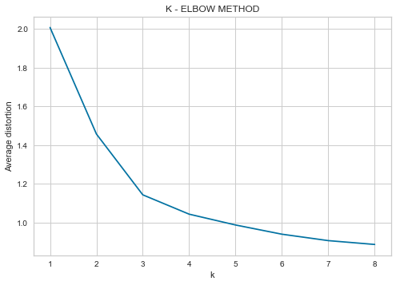
ELBOW METHOD
Number of Clusters: 1 Average Distortion: 2.007896349270688
Number of Clusters: 2 Average Distortion: 1.4576197022077821
Number of Clusters: 3 Average Distortion: 1.1434401208195095
Number of Clusters: 4 Average Distortion: 1.0435538595477063
Number of Clusters: 5 Average Distortion: 0.9876932950805294
Number of Clusters: 6 Average Distortion: 0.9400838295779785
Number of Clusters: 7 Average Distortion: 0.9069417885786603
Number of Clusters: 8 Average Distortion: 0.8871445822197129
OBSERVATIONS
Judging by the graph created above, appropriate value for k can be picked as 3.
k = 2 can also be considered.

Slide 37
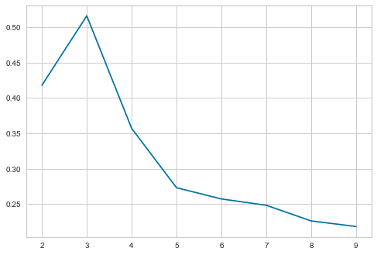
CHECKING SILHOUETTE SCORES
For n_clusters = 2, the silhouette score is 0.41800025566689647)
For n_clusters = 3, the silhouette score is 0.516281010855363)
For n_clusters = 4, the silhouette score is 0.3570238219413198)
For n_clusters = 5, the silhouette score is 0.2730908848204728)
For n_clusters = 6, the silhouette score is 0.25719485802606895)
For n_clusters = 7, the silhouette score is 0.24825112050393752)
For n_clusters = 8, the silhouette score is 0.2260684384828419)
For n_clusters = 9, the silhouette score is 0.21822102395741014)
OBSERVATIONS
Judging by the graph created above, appropriate value for k can be picked as 3.
k = 3 has the highest silhouette score.

Slide 38
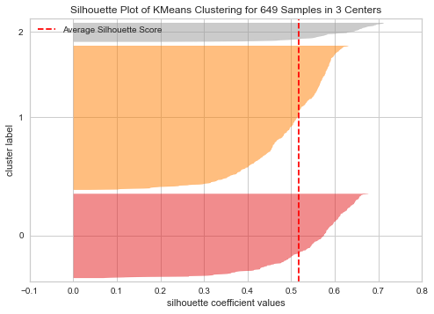
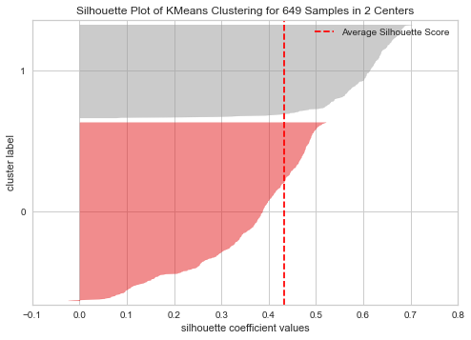
FINDING OPTIMAL NUMBER OF CLUSTERS
OBSERVATIONS
OPTIMAL NUMBER OF CLUSTERS = 3
k = 3 shows a better plot and silhouette score than k = 2

Slide 39
HIERARCHICAL CLUSTERING

Slide 40
1) Finding Cophenetic Correlation
EUCLIDEAN
Single linkage is 0.8782863872563746.
Complete linkage is 0.8854872581962318.
Average linkage is 0.9167886114950704.
Centroid linkage is 0.9140343756244551.
Ward linkage is 0.7756167152597446.
Weighted linkage is 0.9107193273405108.
HIGHEST VALUE
CHEBYSHEV
Single linkage is 0.8976424680148912.
Complete linkage is 0.8731535021949083.
Average linkage is 0.9155524410807189.
Weighted linkage is 0.8894795319631006.
MAHANOLOBIS
Single linkage is 0.8953021845210309.
Complete linkage is 0.5766593216714142..
Average linkage is 0.8455737900742861..
Weighted linkage is 0.8276434296808391.
CITYBLOCK / MANHATTAN
Single linkage is 0.8402227893582106.
Complete linkage is 0.8897533482434944.
Average linkage is 0.9147653836283022.
Weighted linkage is 0.892493133316226..

Slide 41
1) Finding Cophenetic Correlation
OBSERVATIONS
Across all the distances, the BEST COPHENETIC CORRELATION has been given by Average Linkage except in the case of MAHANOLOBIS DISTANCE where the best result was given by Single Linkage
EUCLIDEAN DISTANCE + AVERAGE LINKAGE has given the BEST COPHENETIC CORRELATION

Slide 42
2) Dendogram Construction
For Euclidean, Manhattan and Chebyshev distances.
Mahalanobis Distance had low cophenetic correlation for the various linkages and is therefore being ignored.

Slide 43
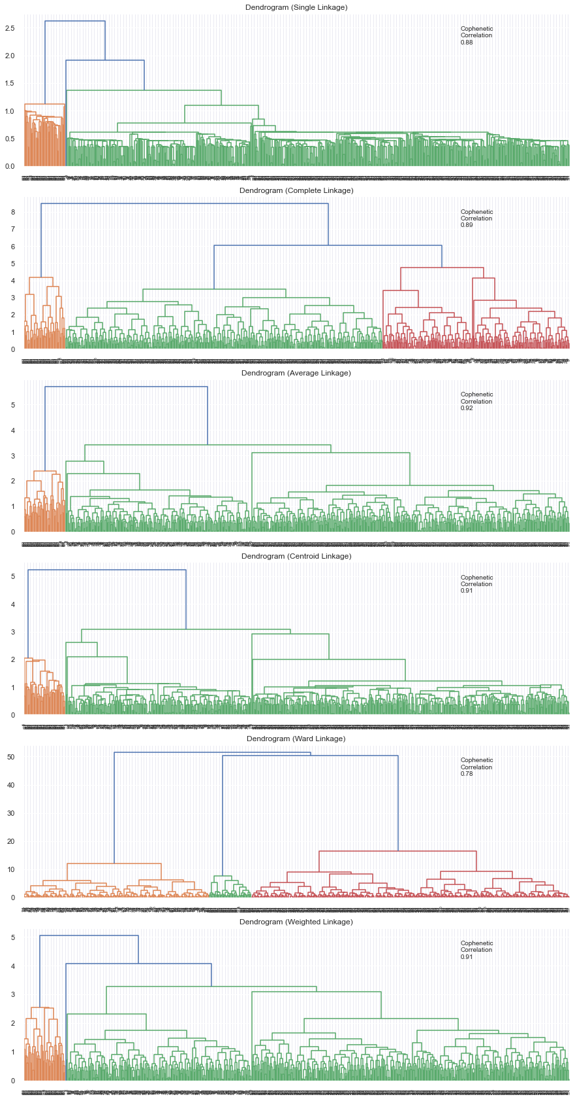
2) Dendogram Construction – EUCLIDEAN DISTANCE

Slide 44
2) Dendogram Construction – EUCLIDEAN DISTANCE
BEST OPTION : WARD LINKAGE
Number of Clusters = 3
Cophenetic Correlation = 0.78

Slide 45
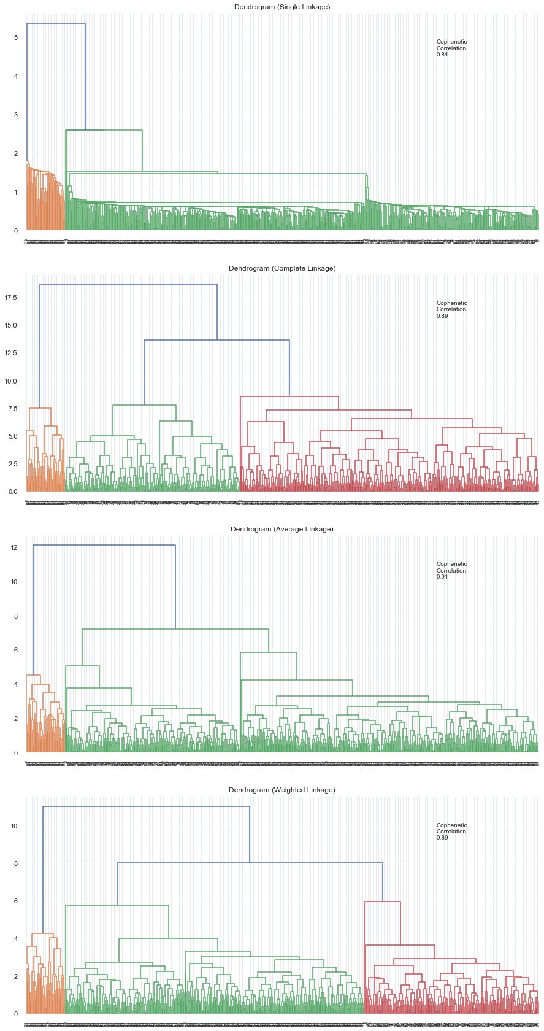
2) Dendogram Construction – MANHATTAN DISTANCE

Slide 46
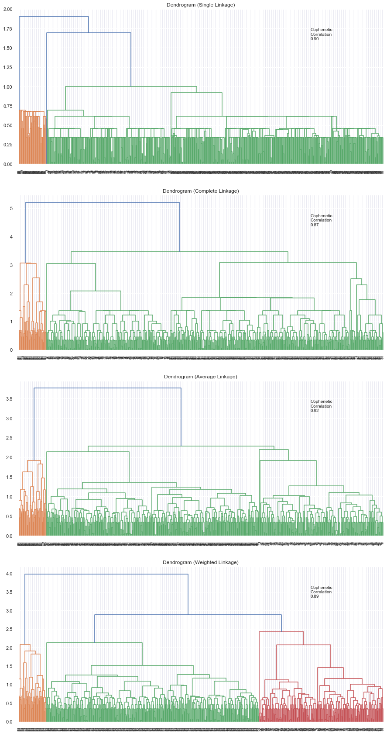
2) Dendogram Construction – CHEBYSHEV DISTANCE

Slide 47
3) Finding Optimal Number of Clusters
Observations
Based on all the dendograms seen above, we can conclude that the graph formed by Euclidean Distance with Ward Linkage is the best combination as it gave us separate and distinct clusters.
OPTIMAL NUMBER OF CLUSTERS = 3 based on the dendogram Euclidean Distance with Ward Linkage

Slide 48
CLUSTER PROFILING

Slide 49
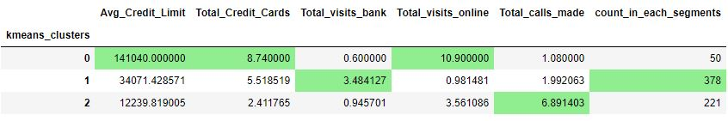
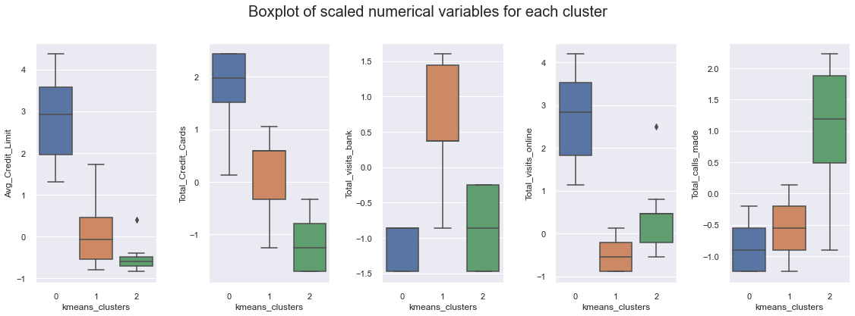
1) K MEANS CLUSTERING

Slide 50
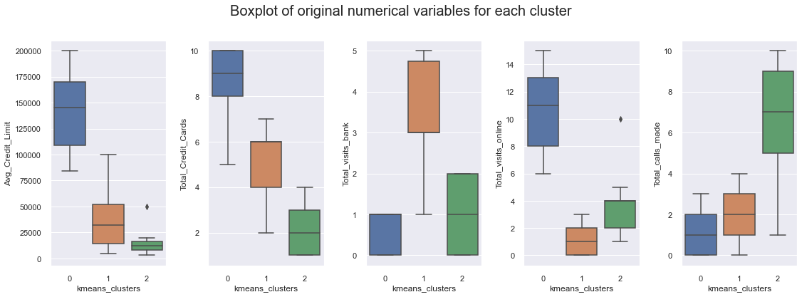
K MEANS CLUSTER INSIGHTS
CLUSTER 0 : High Average Credit Limit, Hold large number of Credit Cards, Rarely ever visits the bank, Highest online visits, Very low number of calls.
CLUSTER 1 : 12500 - 50000 Average Credit Limit, 4 - 6 Credit Cards, Highest visits to bank, Does not visit online banking, Low number of calls.
CLUSTER 2 : Lowest Average Credit Limit, 0 - 3 Credit cards, 0 - 2 visits to bank, 2 - 4 visits to online banking, Highest calls made to bank.

Slide 51
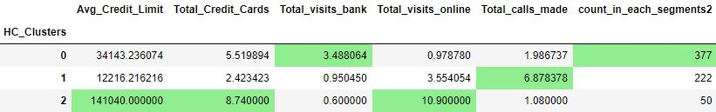
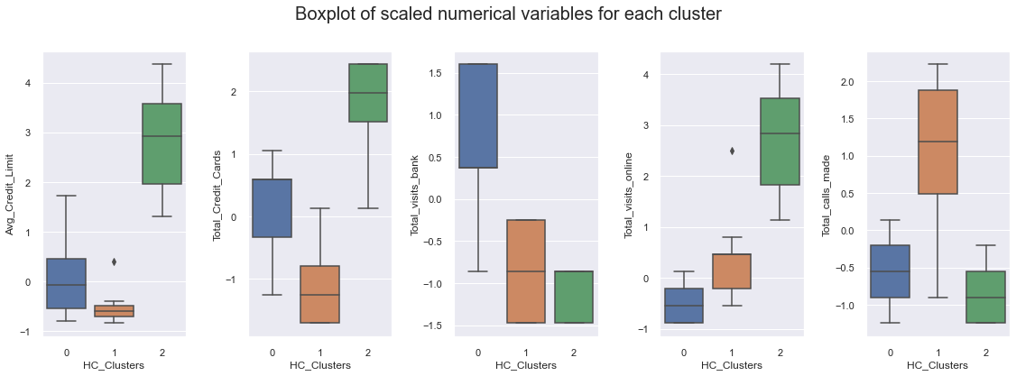
2) HIERARCHICAL CLUSTERING

Slide 52
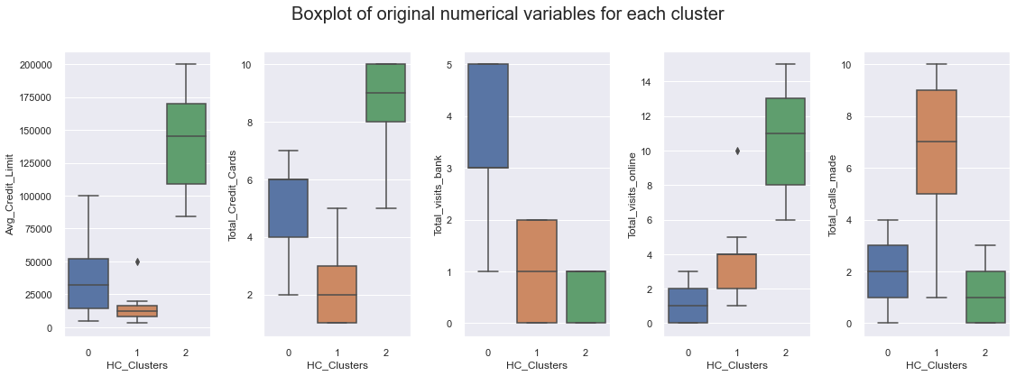
HIERARCHICAL CLUSTER INSIGHTS
CLUSTER 0 : 12500 - 50000 Average Credit Limit, 4 - 6 Credit Cards, Highest visits to bank, Does not visit online banking, Low number of calls.
CLUSTER 1 : Lowest Average Credit Limit, 0 - 3 Credit cards, 0 - 2 visits to bank, 2 - 4 visits to online banking, Highest calls made to bank.
CLUSTER 2 : High Average Credit Limit, Hold large number of Credit Cards, Rarely ever visits the bank, Highest online visits, Very low number of calls.

Slide 53
COMPARING K MEANS AND HIERARCHICAL CLUSTERING
The silhouette value is a measure of how similar an object is to its own cluster (cohesion) compared to other clusters (separation). The silhouette ranges from −1 to +1, where a high value indicates that the object is well matched to its own cluster and poorly matched to neighboring clusters.
K Means Silhouette Score : 0.5616172833106032
Hierarchical Clustering Score : 0.5608391564202945
Observations
Both K Means and Hierarchical Clustering have an average silhouette score of 0.56 which is a good score signifying that the clusters a mostly well formed and distinct.
Both K Means and Hierarchical Clustering have similar scores with k means having a slightly higher score signifying it is marginally better than Hierarchical Clustering.
Both algorithms more or less created clusters with the same clustering profiles.

Slide 54
ACTIONABLE INSIGHTS & RECOMMENDATIONS

Slide 55
KEY TAKEAWAYS FOR THE BUSINESS / RECOMMENDATIONS
K MEANS CLUSTERS
CLUSTER 0 : This cluster seems to indicate that they are the premium customers with higher income. They can be offered premium deals and can be given online shopping deals as they show more affinity towards it.
CLUSTER 1 : Can be targeted for better in person marketing as they tend to come to the bank more. Use medium number of credit cards so can be targeted for more purchase of credit cards. Bank managers can use promotional ads in bank to lure more customers.
CLUSTER 2 : Can be targeted through promotions through phone calls as they use this medium the most. Feedback can also be taken in through phone to encourage better service. Low number of credit cards, so can be targeted for low budget credit cards.

Slide 56
KEY TAKEAWAYS FOR THE BUSINESS / RECOMMENDATIONS
HIERARCHICAL CLUSTERS
CLUSTER 0 : Better service in banks to lure more customers that make higher visits to banks. more advertisements, offers and coupons provided in bank. Mediocre credit limit, keeping this in mind more targeted promotions can be developed.
CLUSTER 1 : Promotions through phone calls. Targeted promotion based on their low income level. Draw interest towards credit cards for low income individuals.
CLUSTER 2 : Affluent customers that prefer online banking. More targeted promotions through online means. Can pitch credit cards with higher spending limits.

Slide 57
THANK YOU

